Slide 1
Mapping Synthesizers to Real-World Instruments
Landon Buell
4 Dec 2020

Slide 2
Let’s Play a Game
What made the sound being played?

Slide 3

Name the Source of the Sound
Example 1:
Violin – G4
Example 2:
Guitar – B2
Example 3:
Clarinet – G#5
Example 6:
Oboe – Bb4

Slide 4
How do you Know?
Humans good at mapping sounds to sources
Can we “teach” a computer to do it?
Practical Example: Classifying Synthesizers

Slide 5
The Neural Network
Introduction / Function / Training

Slide 6
Neural Network?
“Birds inspired us to fly, burdock plants inspired velcro and nature has inspired many other inventions. It seems only logical, then, to look to the brain’s architecture for inspiration on how to build an intelligent machine.”
- Aurelion Geron, Former Youtube Video Classification lead

Slide 7
What is a Neural Network?
A Neural network is a mathematical function
Composed of Layers, with “trainable” Parameters
Transform an Input Array into an Output Array

Slide 8
A Classification Model
We map a set of inputs to a qualitative output
We seek to “group” similar inputs
This model is called a classifier

Slide 9
Training A Network
Provide the model with labeled training samples
The model makes a prediction
For an untrained network, this is likely to be very poor
We quantify the error with an Objective Function

Slide 10
Optimization
Choose parameters to minimize the objective function
Do we Train a Neural Network?
Do wee Optimize a Neural Network?

Slide 11
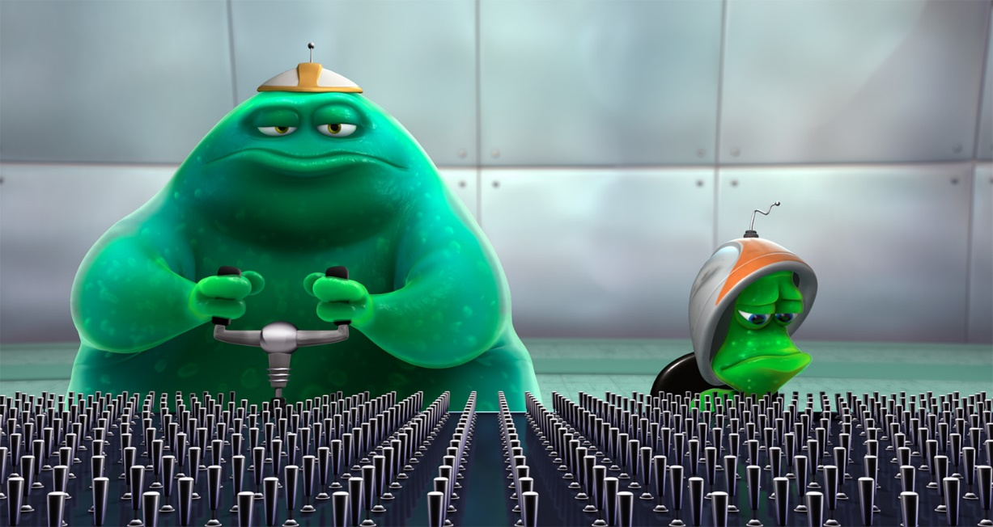
Optimization (Cont.)
“Adaptive-Moments” Optimizer
Gradient Descent Method
Powerful, Robust, Stable
Adjust each parameter to minimize cost function

Slide 12
Features Used
Spectrogram / Time-Series / Frequency Series

Slide 13
How are Features Chosen?
“For recognition algorithms, the necessary property of the acoustic features is low variability among features extracted from examples assigned to the same class, and at the same time high variability allowing distinction between features extracted from examples assigned to different classes”
- Tuomas Virtanen, Machine Learning & Audio Engineer

Slide 14
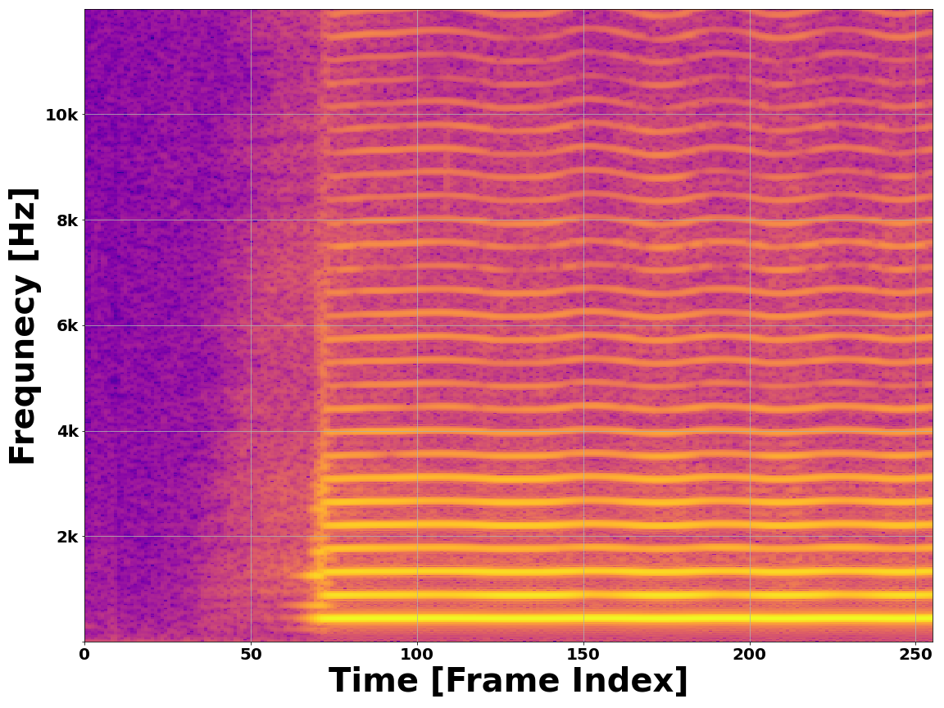
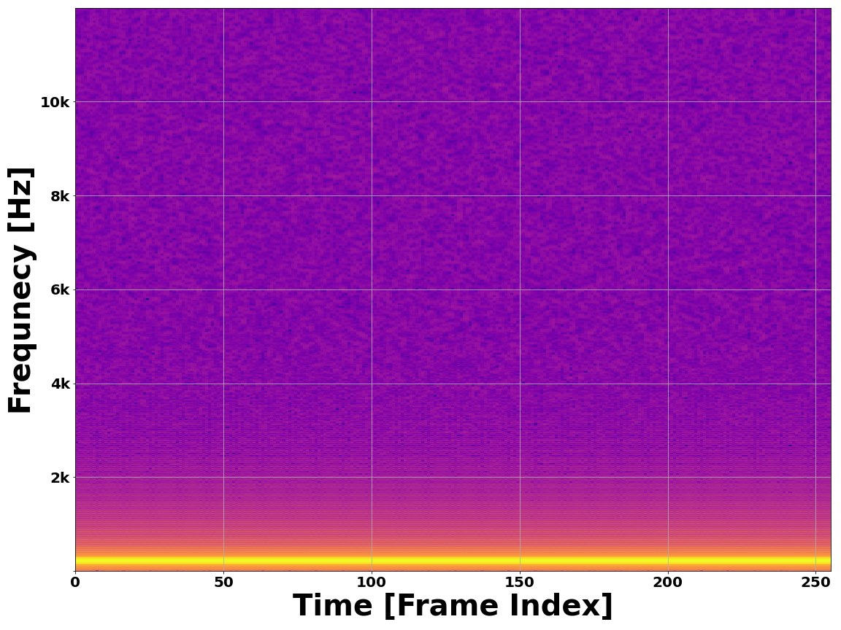
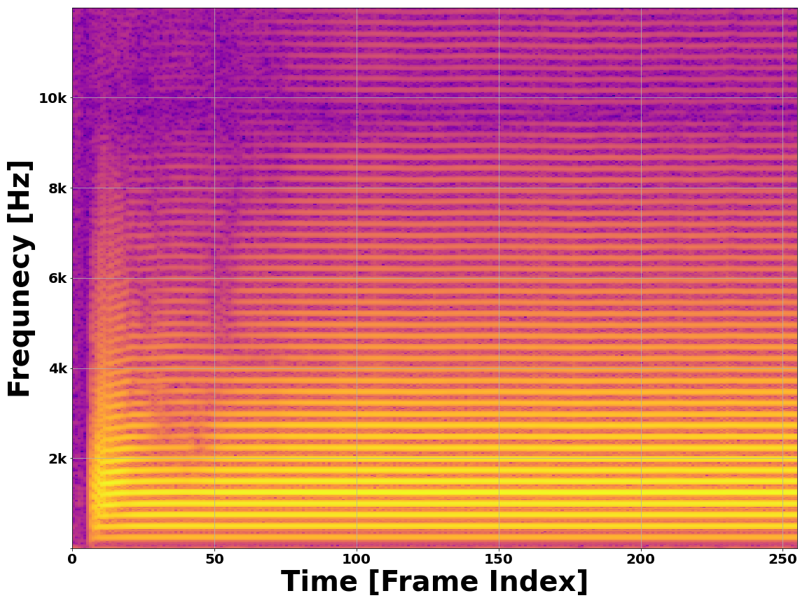
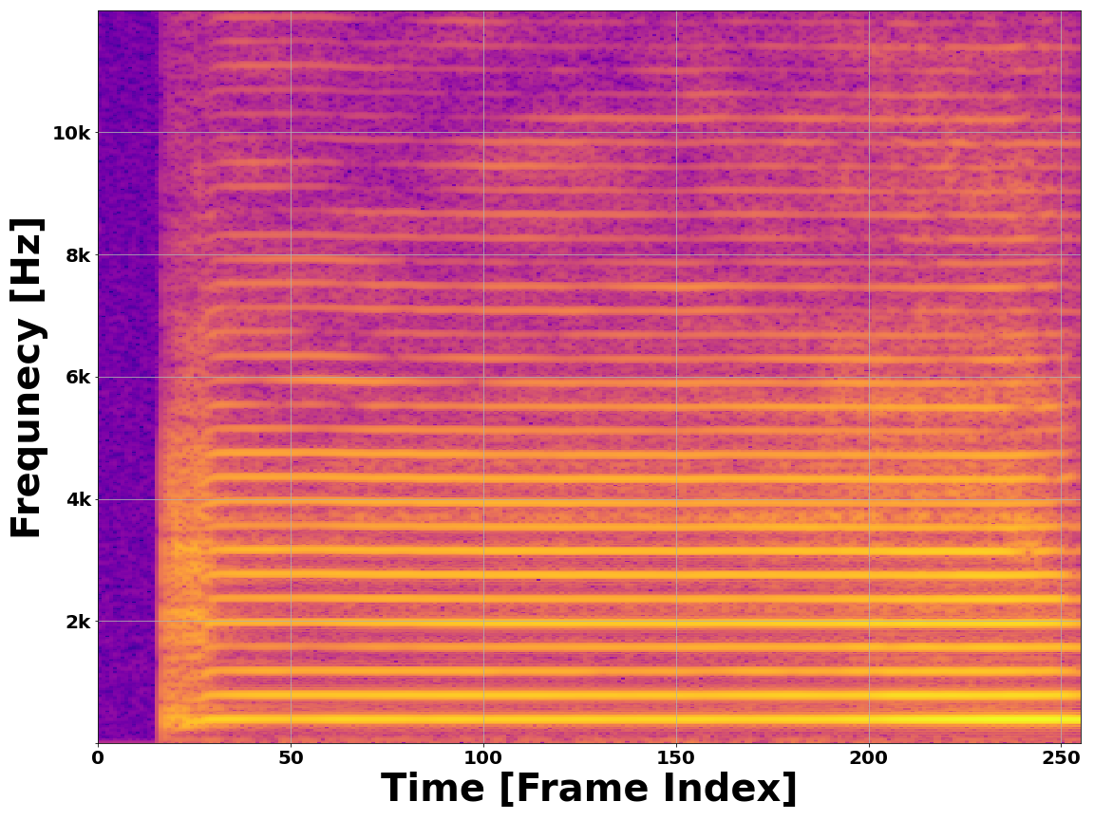
The Spectrogram
Provides a 2D image-like representation of a waveform
Maps energy over frequency and time
Time passes on X-axis
Frequency on Y-axis
Alto Saxophone – A4
Pure Sine – 220 Hz
Bb Trumpet – B3
Violin – G4

Slide 15
Time–Space Features
Time Domain Envelope (x5)
Zero Crossing Rate
Divide waveform into 5 sections
Approximated energy time domain
Compute TDE for each, use as features
Number of times a waveform crosses equilibrium
Identifies Jagged vs. periodic waveforms

Slide 16
Time-Space Features (Cont.)
Temporal Center of Mass
Auto Correlation Coefficients (x4)
Treat waveform as 1D mass-distribution
Short sustains vs. long sustains
Dotting a signal to a time-delayed version of itself
Useful for detecting periodicity

Slide 17
Frequency-Space Features
Mel Frequency Cepstrum Coefficients
Frequency Center of Mass
Detect periodicity in frequency spectrum
Computed using Mel Filterbank Energies
Dot the frequency spectrum with overlapping triangular filters
Treat frequency spectrum as 1D mass distribution
Lower Instruments vs. Higher Instruments

Slide 18
Network Architecture
What do we do with our features?

Slide 19
Dual Modalities
2D Spectrogram vs. 1D Feature Vector
Two modes – convey the same information
Compare to human cardinal senses

Slide 20
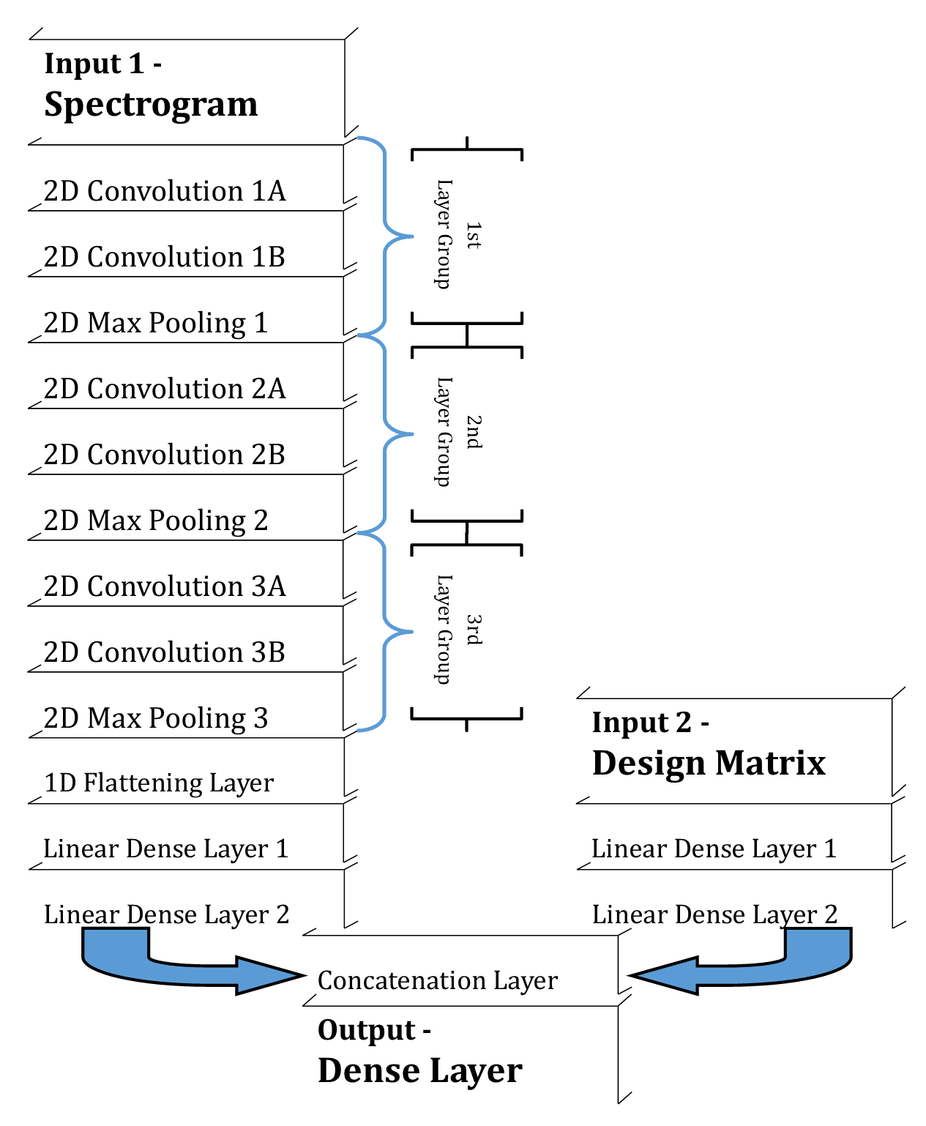
A Hybrid Neural Network
Image is Processed with a Convolutional Neural Network
Vector is Processed with a Mulitlayer Perceptron
Results are Merged to form a single prediction based on both inputs

Slide 21
Does it Work?
Can we trust the model?

Slide 22
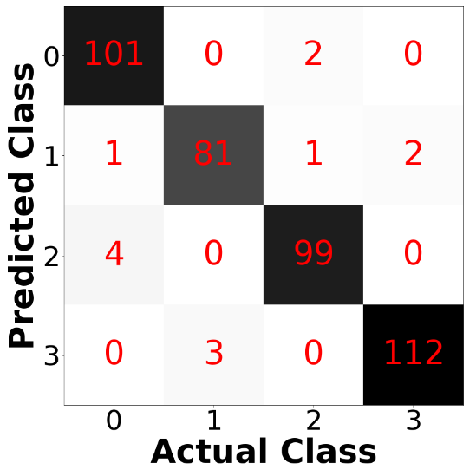
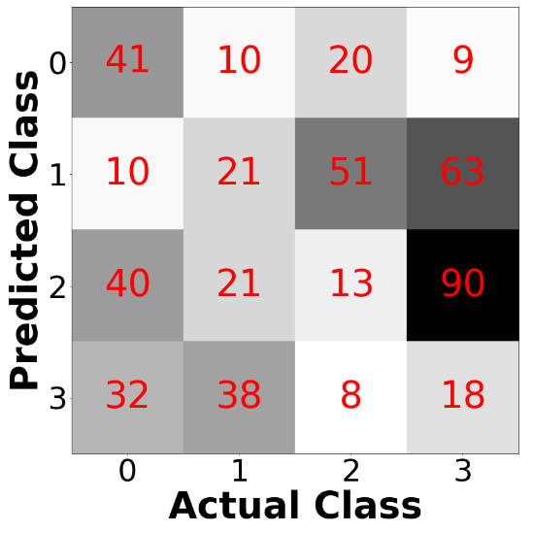
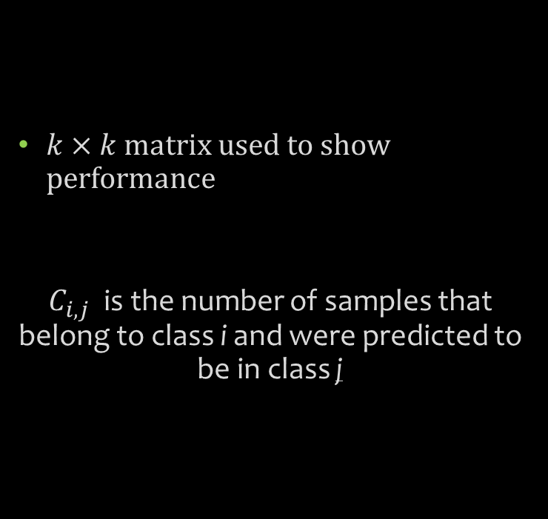
The Confusion Matrix
$k×k$ matrix used to show performance
$C_{i,j}$ is the number of samples that belong to class i and were predicted to be in class j
Diagonal dominance indicates
a stronger model
No diagonal dominance indicates
a weaker model

Slide 23
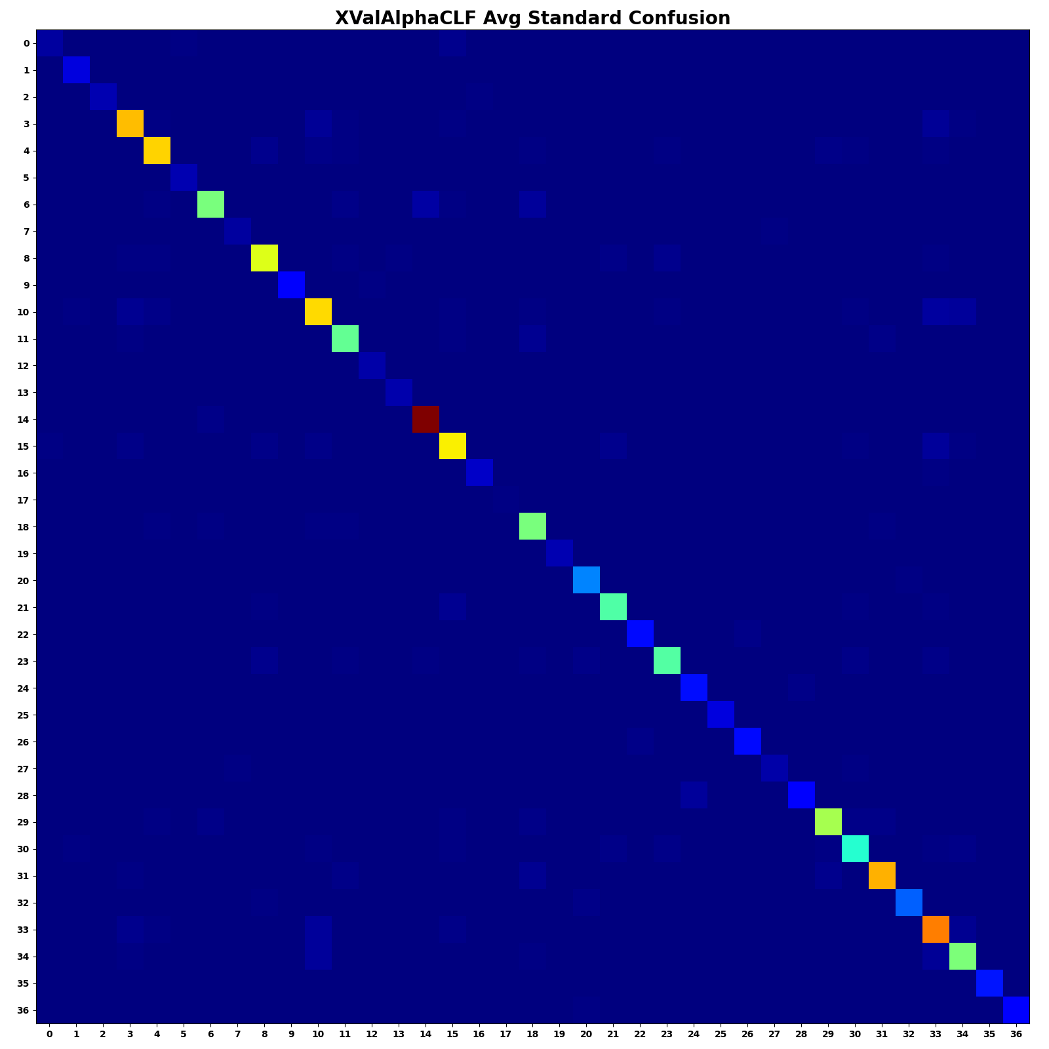
The Standard Confusion Matrix
Averaged over K=10 Folds Cross Validation

Slide 24
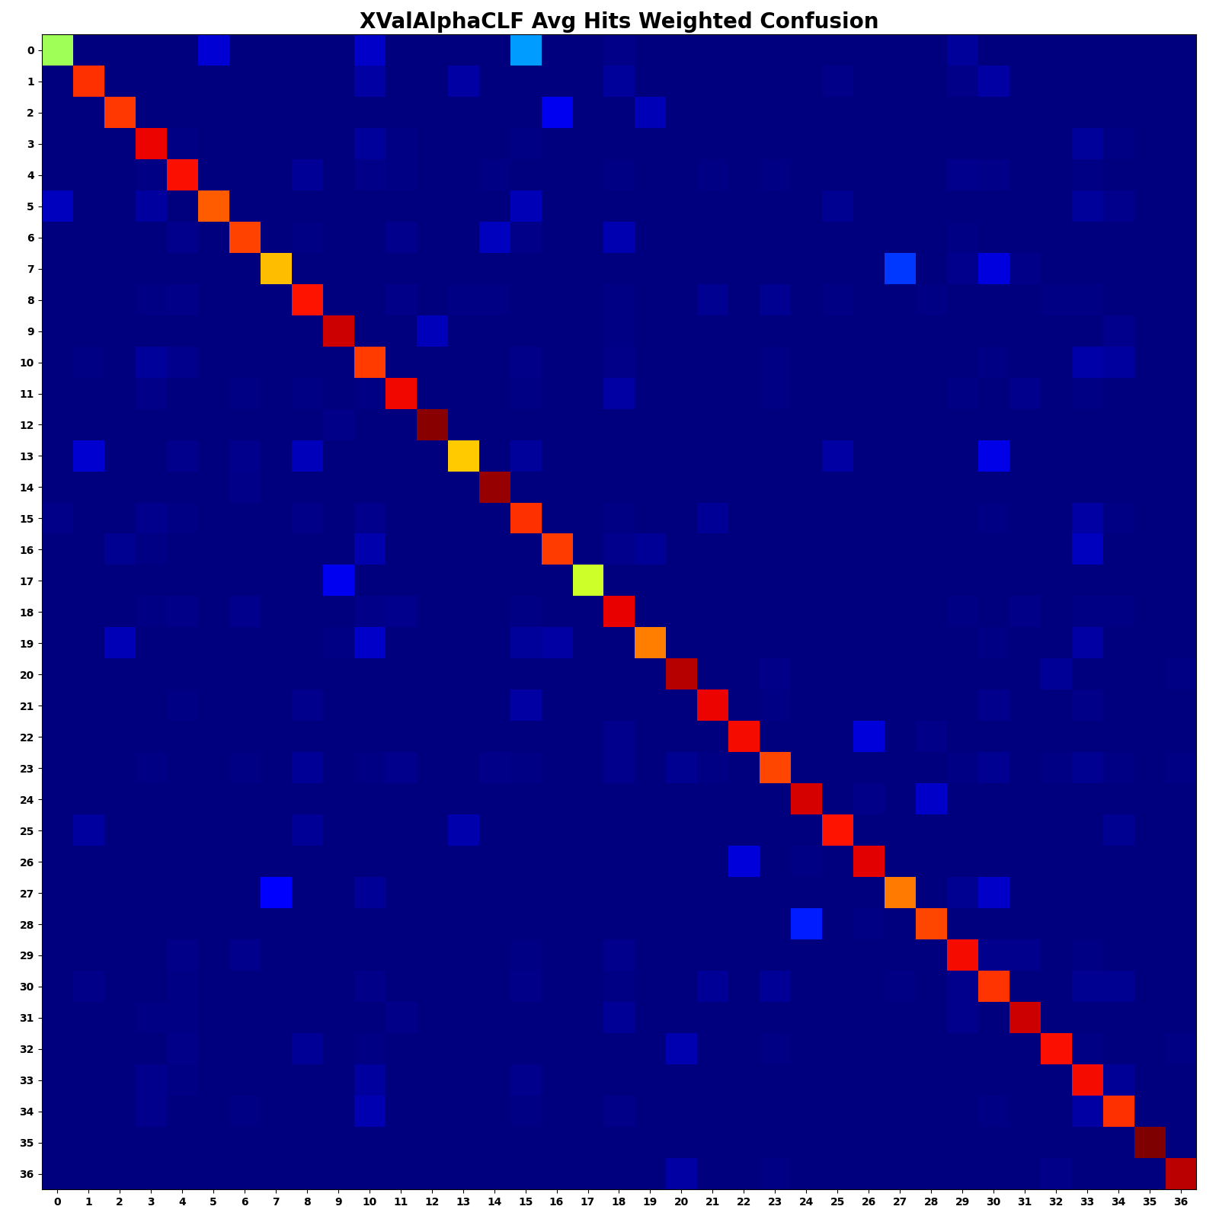
The Hits Weighted Confusion Matrix
Averaged over K=10 Folds Cross Validation
Account for occurrence of each class

Slide 25
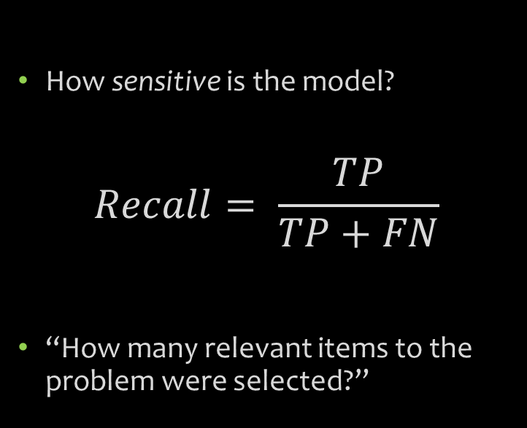
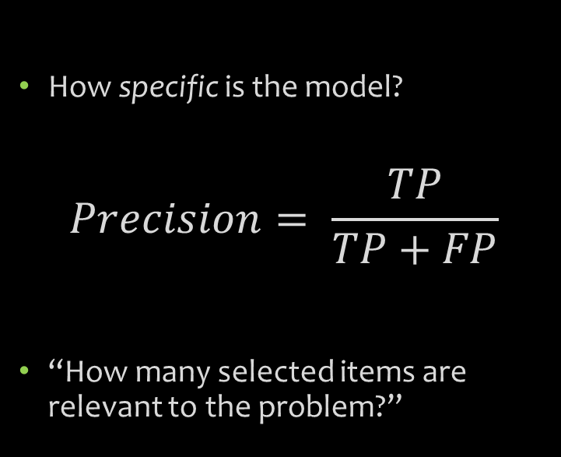
Quicker Metrics
Precision / Specificity Score
Recall / Sensitivity Score
How specific is the model?
$$Precision= \frac{TP}{TP+FP}$$
“How many selected items are relevant to the problem?”
How sensitive is the model?
$$Recall= \frac{TP}{TP+FN}$$
“How many relevant items to the problem were selected?”

Slide 26
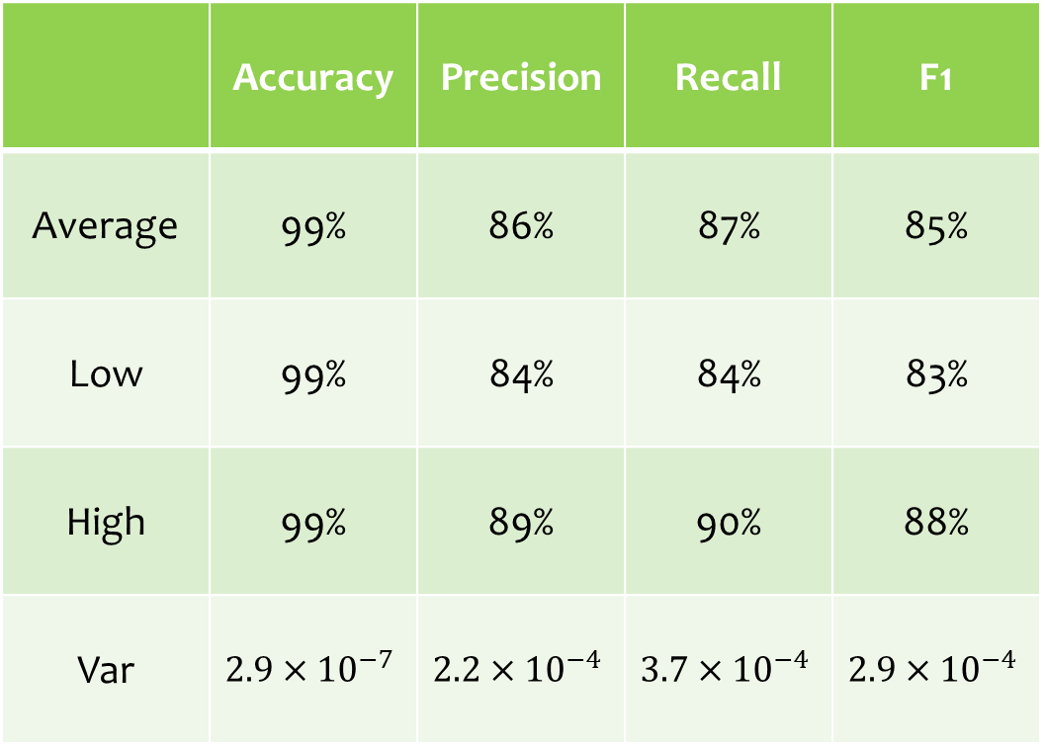
So what?
 | Accuracy | Precision | Recall | F1
Average | 99% | 86% | 87% | 85%
Low | 99% | 84% | 84% | 83%
High | 99% | 89% | 90% | 88%
Var | $$2.9×{10}^{−7}$$ | $$2.2×{10}^{−4}$$ | $$3.7×{10}^{−4}$$ | $$2.9×{10}^{−4}$$
When all is said and Done…
Averaged over 10 folds
Averaged Across 37 classes

Slide 27
Questions?
Thank you!

